Slide 1
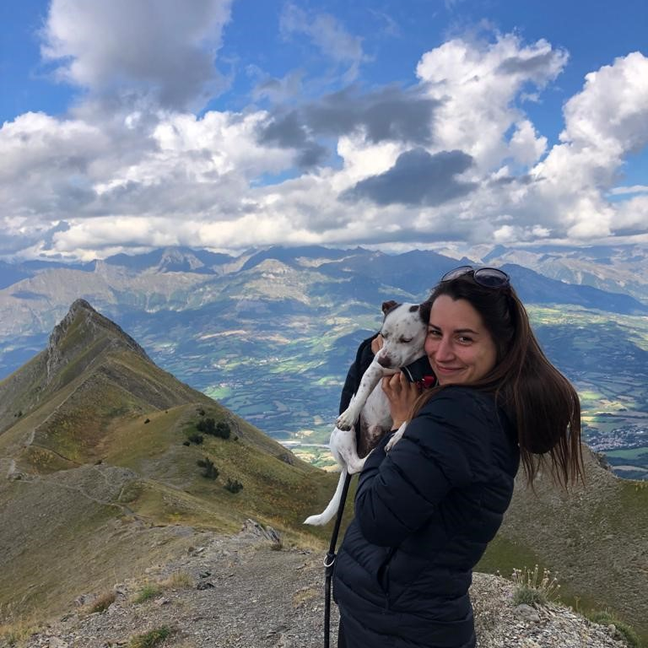
Ewa Szustak
Communications Specialist & outdoor lover
Warsaw/Remote
Wanna know more about our EB campaigns, events or any other marketing activities? Ask away!
I enjoy traveling with my furry friend Poco, discovering new food and climbing some rocks
Here’s how you can reach me:
+48 604 051 100
ewa.szustak@eu.rsystems.com

