Slide 1
GoTech 2022 – ACT NOW
November 3-4, 2022. Employer branding event report

Slide 2
Contents
Event/campaign/project overview
Objective
Event/campaign/project description & implementation
Media and promotion
Staffing
Costs
Results, feedback
Conclusions & recommendations

Slide 3
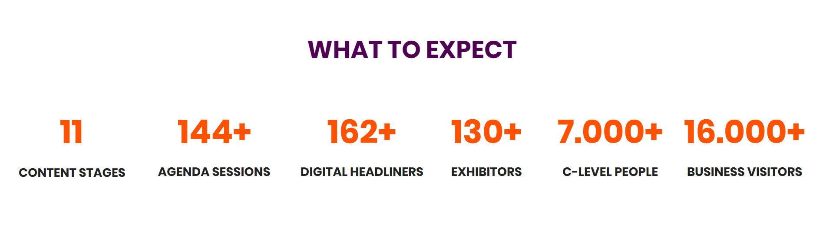
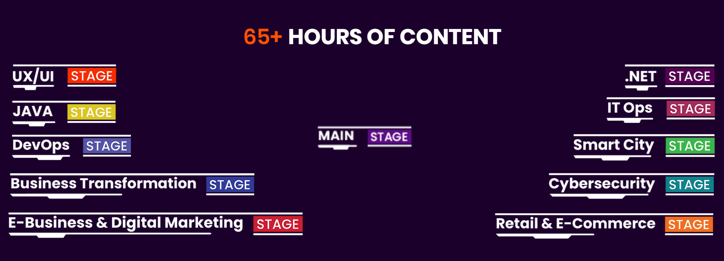
GoTech World Overview
https://www.gotech.world/
- 3-4 November 2022; in-person, Romexpo

Slide 4
Objectives
Increase brand awareness in the IT & tech community
Build database of potential candidates
Generate traffic to careers page
Presence as gold partner/exhibitor in one of the largest IT events
Quiz competition to generate leads
QR code to careers page on branded assets
Activation at the stand to generate traffic
Badge scanning to collect contact details
Social media comms #gotech

Slide 5
Gold Partner @GoTech 2022
EXPO & BRANDING
Presentation booth for 2 days | 18 sqm
Advertisment in event catalogue | 1 page
Company presentation on event website | yes
Company listing & description on event digital signage | yes
Blog post & social media sharing | 1 posts
Access to MyConnector visitors networking platform | yes
Event passes for employees or premium clients | 40 Standard Passes
Discount for the acquisition of additional event passes | 15%
TOTAL | 3,250 €

Slide 6
Exhibitors area map (stand location)

Slide 7
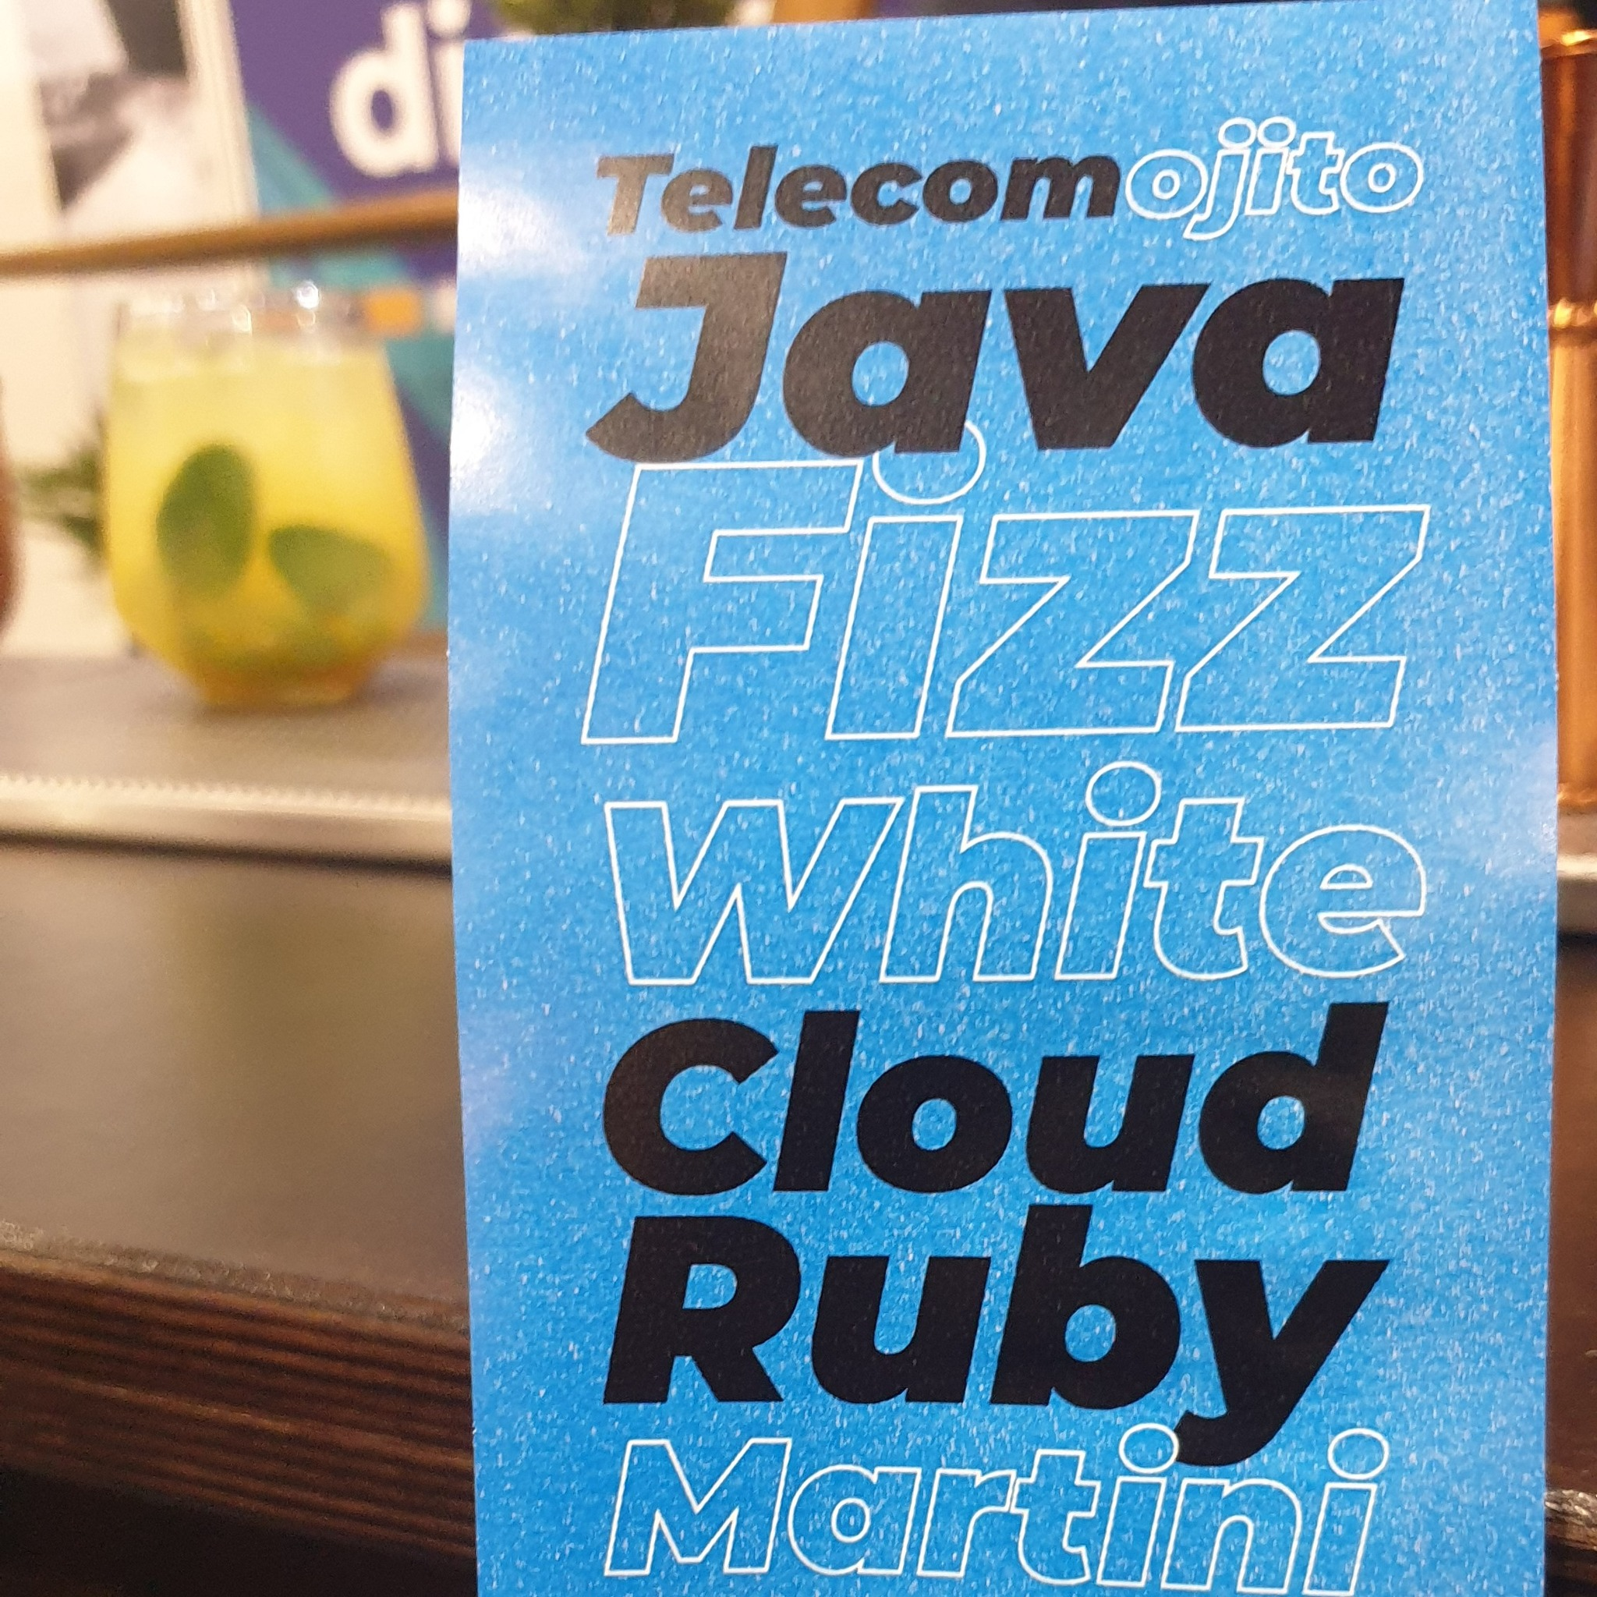
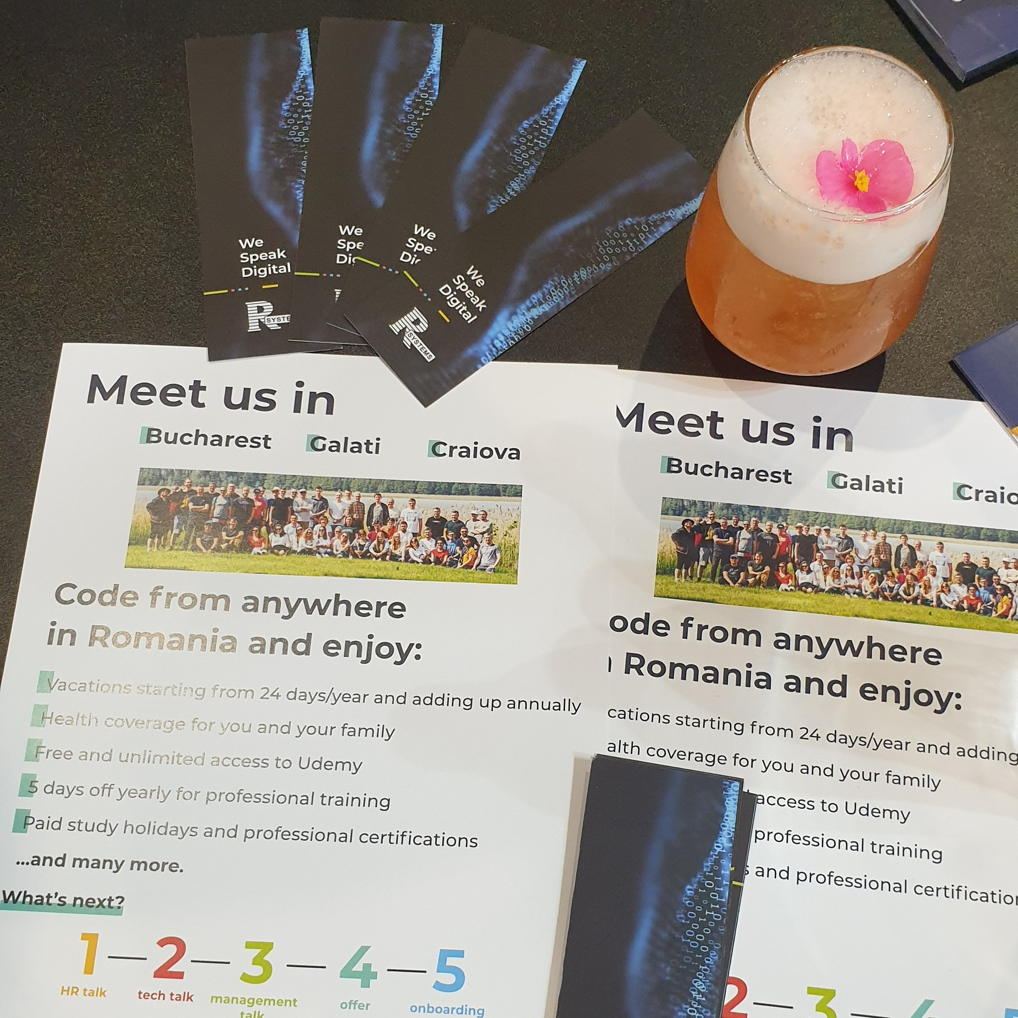
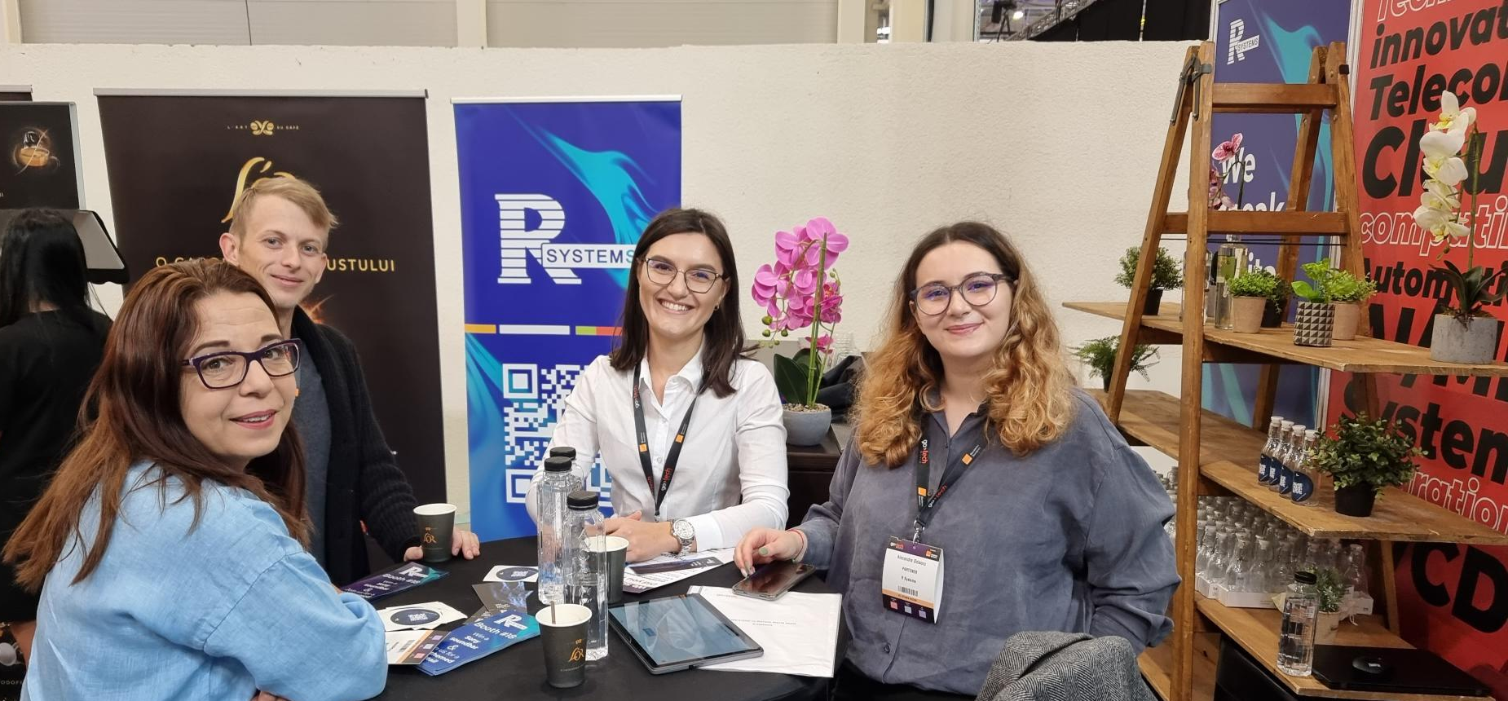
Stand setup & assets
Branded panels (own design, external production)
Bar (external provider)
1 high table & 2 high chairs (rented)
2 tablets for the quiz
1 roll-up
flyers - Bar menu (front) & competition invite (back)
“Riddle me tech” quiz (via website&Typeform)
Laptop stickers, bookmarks, A4 flyers

Slide 8
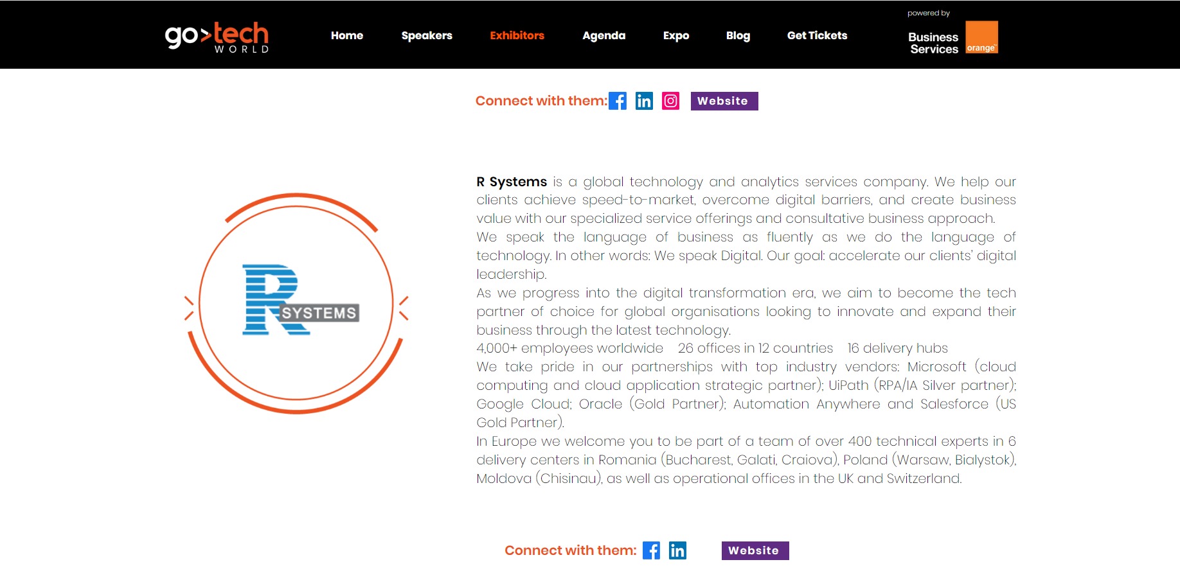
Media and promotion
Event
Own
Facebook
LinkedIn
Instagram1, 2

Slide 9
Team @ GoTech 2022
On site:
recruitment: Monica Negru, Stefania Moise, Elia Negraru, Alexandra Onisoru, Loredana Danila
Marketing: Andreea Ciuluvica, Andreea Serban, Dorina Burcea
Tech: Valentin Suruceanu, Florin Ganea, Catalin Vamesu, Bogdan Zaharie
Organization:
- marketing: Roxana Rosca, Andreea Serban, Dorina Burcea, Catalin Oltei, Maria Paraschiv, Andreea Ciuluvica

Slide 10
Costs
Total | 6,000 eur
Partner package | 3,250 eur
Stand setup | 590 eur
Bar activation | 1,700 eur
Furniture rental | 120 eur
Competition prize | 150 eur
Printed materials | 190

Slide 11
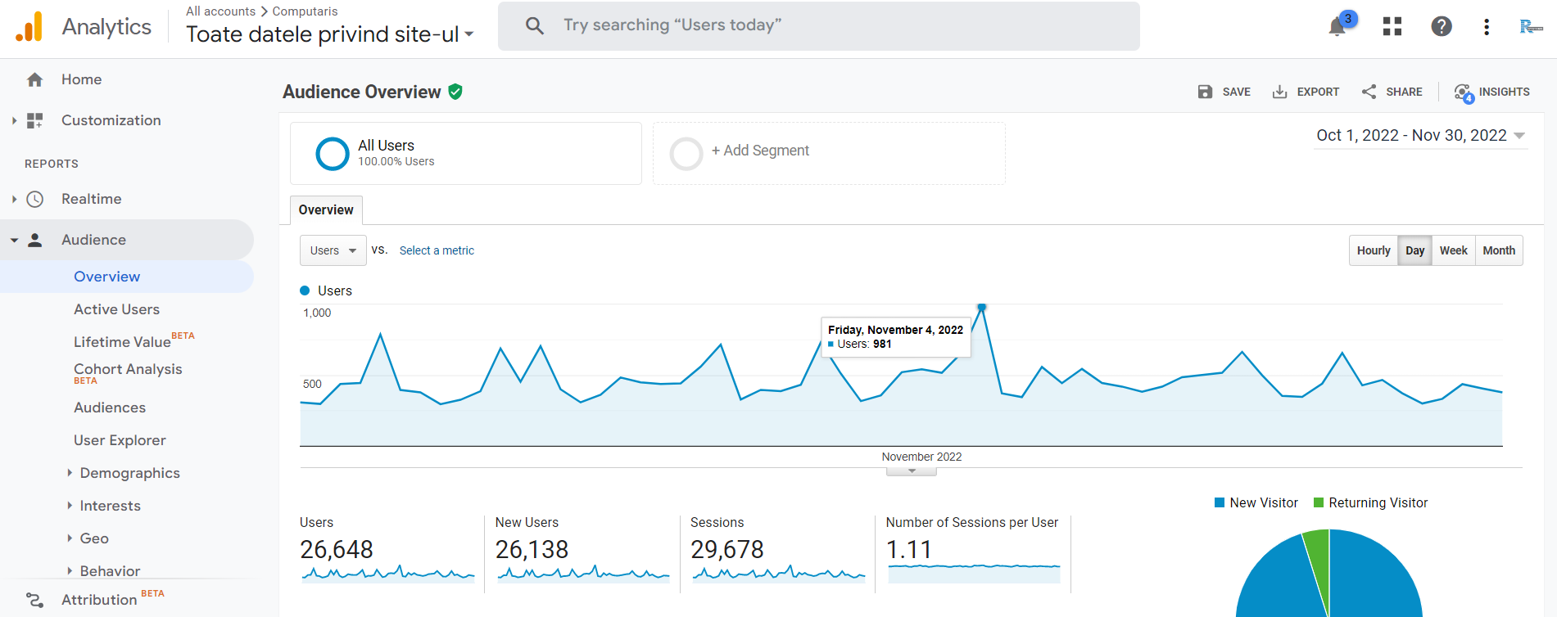
Results
200+ contact details collected by recruitment team via MyConnector badge reader app
120 participants in the quiz, 180 unique hits on the quiz LP
50% increase in website traffic and 80% increase in direct traffic, during the 2 days of the event vs previous period

Slide 12
Conclusions & recommendations
The event had high attendance on the first day (less than half on the second day), very engaged public, open to discuss at the stand – to be considered for next year participation but with a keynote to increase visibility and traction
The bar was an effective activation, generated good traffic at the stand
The quiz was very appreciated, people would recommend it to their friends – rated as challenging but attractive and creative
The event app didn’t allow direct messaging, only scanning badges to collect contact details – follow-up by recruitment is essential to properly qualify the leads
Ready made stand to be used at future events

Slide 13
Thank You.
eu.rsystems.com
Notes:
And now I would like to open the Q&A session.

